Slide 1



WELCOME TO YOUR INTRODUCTION TO COURSE REGISTRATION
Jennifer Morocco, Registrar

Slide 2


First Year Course Registration 2026
Congratulations, we are so glad that you have chosen Huron and look forward to welcoming you to campus in September!
Year 1 students and incoming transfer students will receive an enrolment appointment. An enrolment appointment marks the date/time that Student Center, which is the system you will log into, to complete your registration in courses.
Your enrolment appointment is assigned between June 22nd and June 26th.
Students can make changes to course registration up until September 17, 2026 for any fall term course that is worth 0.5 credits or 1.0 credit full year course

Slide 3

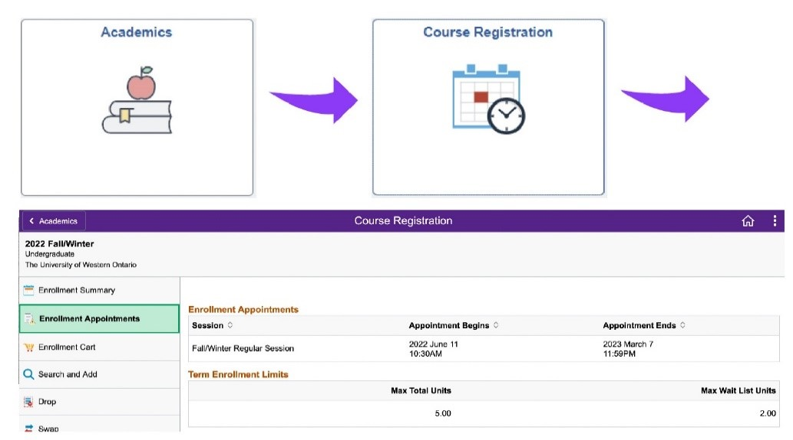
WHAT IS AN ENROLMENT APPOINTMENT?
An enrolment appointment marks the date/time that Student Center will allow you to register in your courses.
HOW DO I KNOW WHEN MY ENROLMENT APPOINTMENT WILL OCCUR?
Your enrolment appointment is randomly assigned to you the Friday preceding the first-year course registration window, which is June 22nd- June 26th. Once your enrolment appointment has been reached, you will be able to begin the course registration process. To find out when your enrolment appointment will occur log into Student Center. Click on the Academics tile > Course Registration tile > Enrolment Appointments tile (see diagram below for further details).

Slide 4

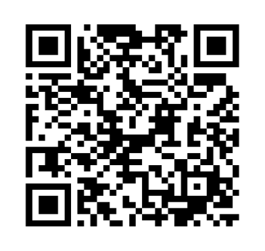
I HAVE SO MANY QUESTIONS AND DON’T KNOW WHERE TO START!
IS THERE SUPPORT AVAILABLE TO ME?
We recommend all incoming students attend a course registration session, hosted by our Academic Advising team!
Our course registration session provides all the information you need to navigate course selection, academic polices and processes, program requirements and resources. Academic Advisors will guide you through the process and help answer all the questions you have about course registration.
We offer course registration sessions in-person or virtually over zoom. You are welcome to join as many course registration sessions as you wish! Please see the Huron Course Registration page for further information about our sessions.
QR code link to Huron Course Registration page!

Slide 5
I AM EAGER TO GET STARTED AND MY ENROLMENT APPOINTMENT WILL BEGIN BEFORE I CAN ATTEND A COURSE REGISTRATION SESSION,
WHAT SHOULD I DO?
You are welcome to review the resources located on our Course Registration webpage, which includes our Course Registration session recordings (FASS and MOS recordings are available) and our First-Year Course Registration Guide.
You can begin drafting your schedule. The Draft My Schedule Tool allows you to draft/build your schedule, save and modify your drafted schedule. Please note you must also finalize your course registration in the Student Center when your enrolment appointment is reached.
You are welcome to register in your courses once your enrolment appointment is reached. Once you have attended a course registration session, or watched a recording of the course registration session, and registered in your courses, please reach out to academic.advising@huron.uwo.ca We will connect you with your Academic Advisor. Your Academic Advisor will review your course selection and ensure you have chosen courses correctly for your desired program!
Reminder: Students can make changes to their course registration up
until the deadline which is September 17, 2026 for any fall term course
that is worth 0.5 credits or 1.0 credit full year course.
QR code link to Huron Course Registration page!

Slide 6

Virtual Course Registration Sessions
Thursday June 25th, 2026 1pm
Tuesday June 30th, 2026 9am
Tuesday July 7th, 2026 1pm
Tuesday July 14th, 2026 10am
Tuesday July 21st, 2026 1pm
Tuesday July 28th, 2026 10am
Log into Western Zoom first and then click on the link for your program:
BMOS students please use BMOS zoom link: Join our Cloud HD Video Meeting
Faculty of Arts and Social Science students please use FASS zoom link: Join our Cloud HD Video Meeting
In-Person Course Registration Sessions
Monday June 29th, 2026 10:00am
Monday June 29th, 2026 1:30pm
QR code linking to Huron
Course Registration page!

Slide 7
FOLLOW THESE STEPS TO COMPLETE COURSE REGISTRATION
Step 1: Activate your Western Identity
Activate your Western Identity, uwo email and download Duo (multi-factor authentication):
Activating Your Western Identity – Western Technology Services – Western University
Download multi-factor authentication Setup MFA – Western Technology Services – Western University (uwo.ca)
Please note that we will use your uwo email account going forward for all communication with the University.

Slide 8
Step 2: Attend a Course Registration Session or watch the recording of our Course Registration Session
and review the Huron Course Registration Guide
Our Huron Course Registration Guide has been developed by Academic Advising to help you navigate course registration and is a valuable resource for students to better understand their course registration process.
QR code linking to Huron Course Registration page!

Slide 9

Step 3: Review Western Academic Calendar
Western Academic Calendar is where you will find a list of Huron programs and their admission and progression requirements. The admission requirements will outline the courses you must take in your first year and averages you must meet to be eligible for your desired path of study. Western Academic Calendar is also where you will find admission requirements for all programs/modules offered at Huron, King’s and Western- main campus.
If you are interested in pursuing a minor at another campus, that is not offered at Huron you will wish to connect with the Faculty under which the program is housed at the other campus. Huron academic advising cannot advise for a program that is not offered at Huron.
Western Academic Calendar is also where you will find sessional dates (important dates and deadlines) and academic policies.
QR code linking to Western Academic Calendar

Slide 10
Step 4: Draft your Schedule
To begin the Course Registration process log into the Draft My Schedule Tool. This tool allows you to draft/build out your schedule, you can save and modify your drafted schedule or create more than one version before you finalize your registration in Student Center

Slide 11


Step 5: Submit your Course Registration in Student Center
Log into Student Center
This process is much like on-line shopping. Search and add the courses to your enrolment cart and finalize your enrolment.
To review the courses you are registered in, please see your Enrolment Summary.
Your current schedule can also be viewed in “calendar format” by logging back into Draft My Schedule Tool and viewing “My Current Schedule”.
The Huron Course Selection and Registration Video will guide you visually through how to register in courses via Student Center.

Slide 12

Understanding First Year
First year is general and you are not limited to your future choices
Select first year courses (1000 level) that keep your options open for a variety of modules/programs
Explore beyond first year and look ahead at the programs/modules in Western Academic Calendar
Programs have prerequisites to be eligible in Year 2 (some have more than one course requirement) – you can find this information in Western Academic Calendar
Courses have limited space, so it is wise to register early to ensure you can access your preferred courses

Slide 13
PROGRAMS AVAILABLE AT HURON
AESL | Animal Ethics and Sustainability Leadership
Global Social Innovation | Cultural Forces of Global Change, Global Development, Global Gender Studies, Global Health Studies, Global Social Innovation, Global Rights Actions
Chinese, Japanese, and East Asian Studies | East Asian Studies, Japanese Studies, Japan Studies, Chinese Studies, China Studies, Chinese Business Communications
Economics | Economics, Finance, Economic Theory
English and Cultural Studies | English and Cultural Studies, Global Great Books, Contemporary English Literature, English for Teachers, Global Great Questions in Arts and Music
French Studies | French Studies
Governance, Leadership, and Ethics | Governance Leadership and Ethics, Environmental Stewardship
History | History, Chinese History, Histories of Africa and the African Diasporas, History of the Book, Pacific Rim Studies; Public History, Studies in Imperialism, The Atlantic World, World History
Management and Organizational Studies | Accounting, Business Intelligence, Finance and Administration, Marketing and Sustainability, Organizational Studies Policy and Ethics
Non-Departmental | Arabic, Environmental Science, Hebrew,, Math, Writing
Philosophy | Philosophy, Philosophy Reasoning and Ethics, Philosophy in Commerce, Ethics, Religious Studies
Political Science | Political Science
Psychology | Psychology
Theology | Religion and Theology

Slide 14


Slide 15





huronu.ca | @huronuni

